Slide 1
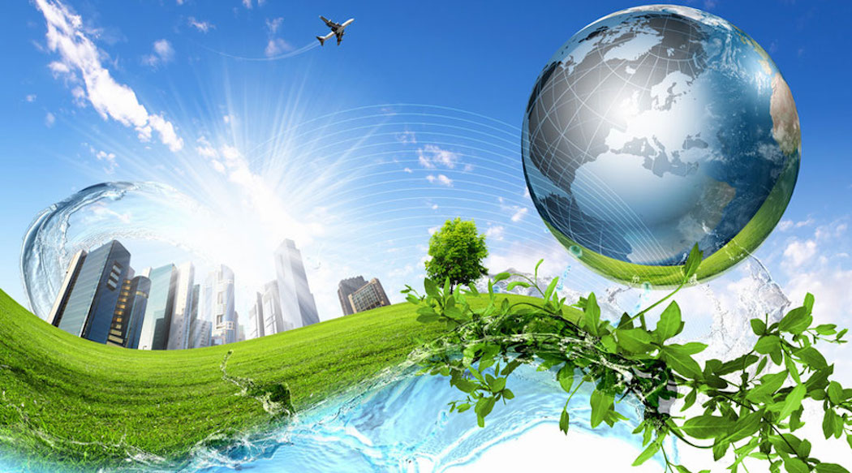
CLIMATE CHANGE
ARE WE MAKING THE WORLD WE WANT ?!!
Notes:
Hello Everyone. Today I will present a very sensitive topic on the climate change in this world. I want to emphasize on the difference between the word that everyone expects the future to be and the world that we are actually working towards.

Slide 2
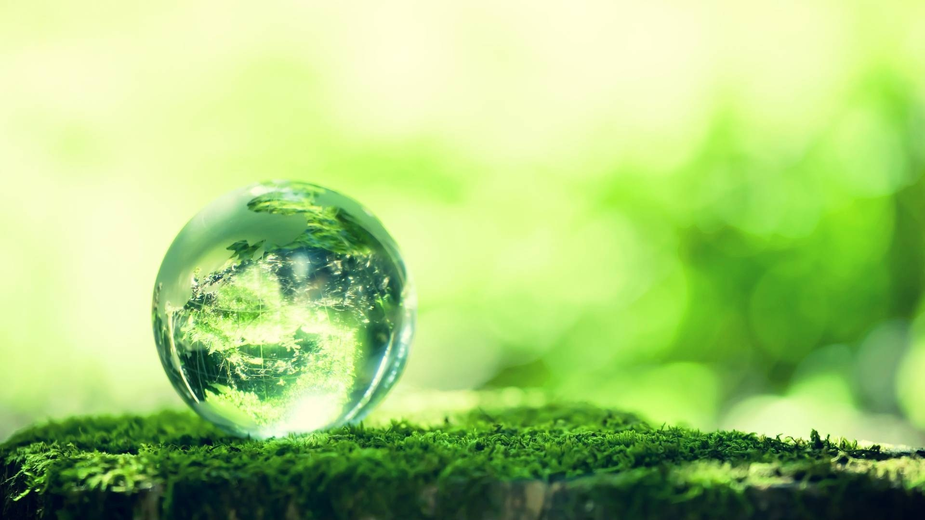
MASTER SLIDE
The earth that we desire is a green and sustainable future earth.
The earth that we are making through our human activities is an earth that cannot sustain life in the near future.
Carbon emission into the atmosphere causes the green house effect which increases the temperature of the earth leading to global warming.
Notes:
The earth that we desire is a green and sustainable future earth. Right?
But is that what we are building in reality?
The earth that we are making through our human activities is an earth that cannot sustain life in the near future.
Carbon emission into the atmosphere causes the green house effect which increases the temperature of the earth leading to global warming.
We are essentially heading towards the extinction of our earth.

Slide 3
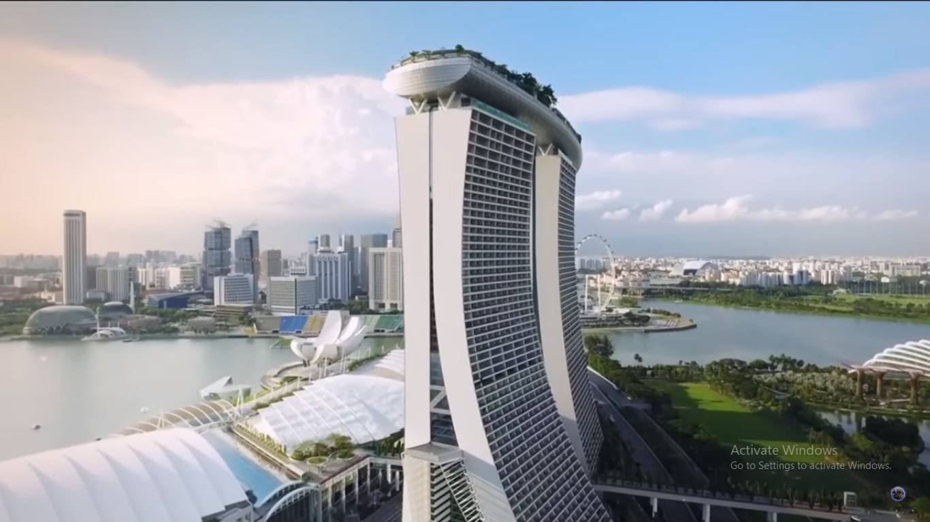
THE EARTH WE WANT https://www.youtube.com/watch?v=ABrjdyavqkI
Notes:
I would like to present to you what I would term the future that everyone would indeed desire for the earth. (https://www.youtube.com/watch?v=ABrjdyavqkI

Slide 4
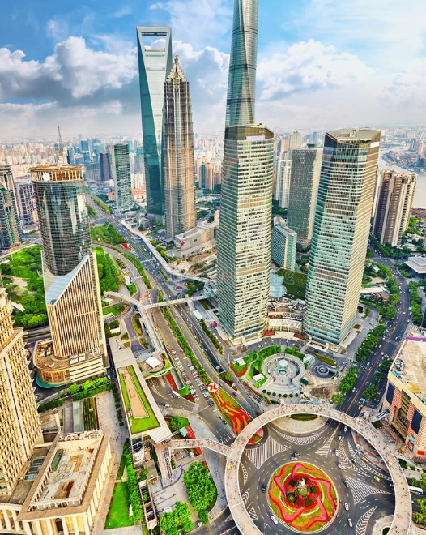
WOULD YOU NOT WANT SUCH A FUTURE?!!
Notes:
Okay would you all agree with me that you would want to live or rather your grand children to live in this earth in the near future.

Slide 5
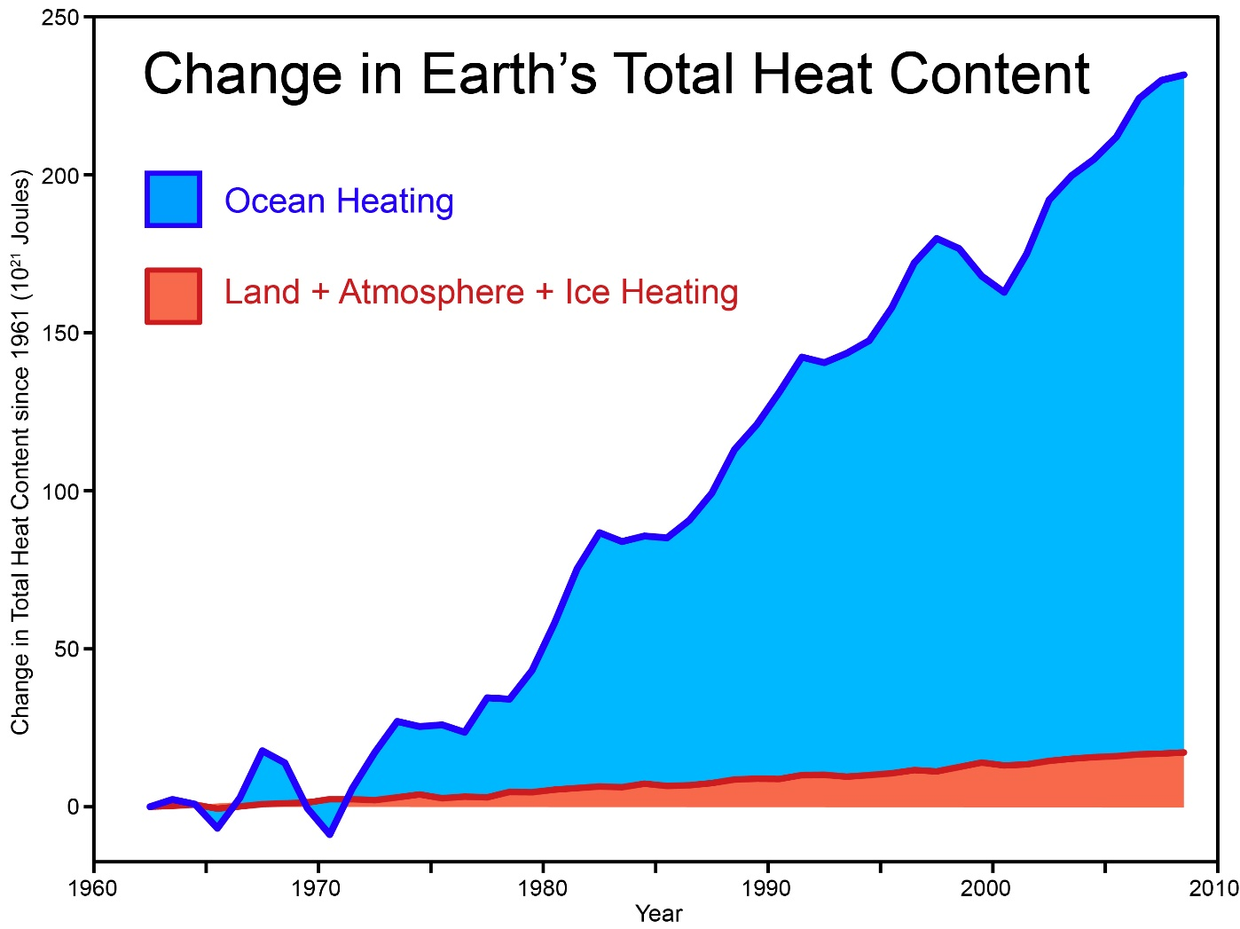
WHAT WE ARE MAKING OF OUR FUTURE
Notes:
As you see we were killing future. The content of heat has been drastically increasing on earth since 1960.

Slide 6
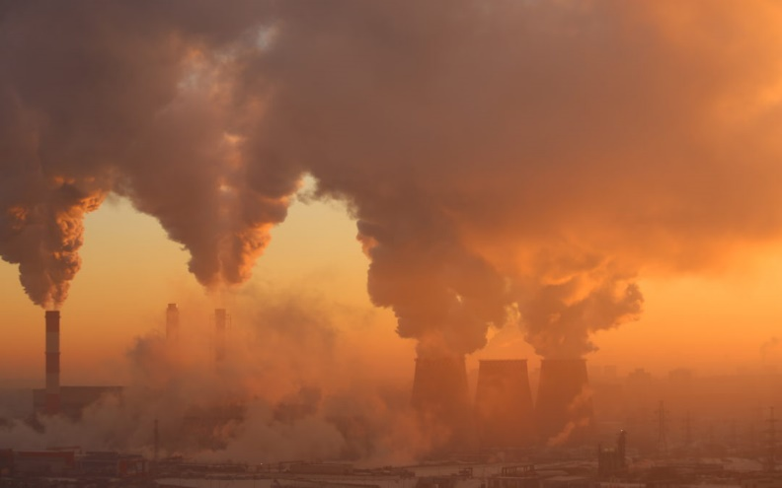
Notes:
The content of the pollution on the earth atmosphere is on extreme.

Slide 7
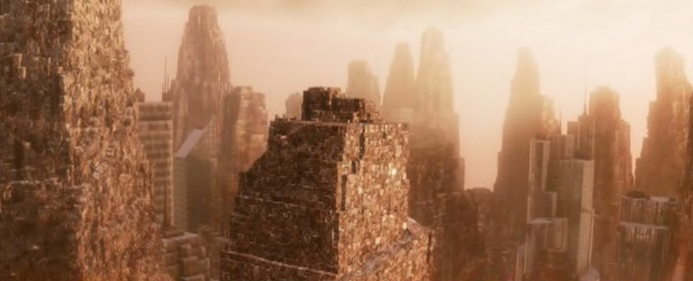
Notes:
Sooner than late, at the rate of pollution that we currently have on earth, we will have cities of garbage for sky capers.

Slide 8
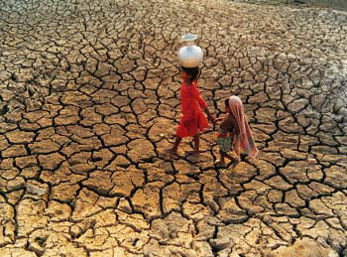
Notes:
Even as we speak, the challenge of draught affect more than half the population on earth.

Slide 9
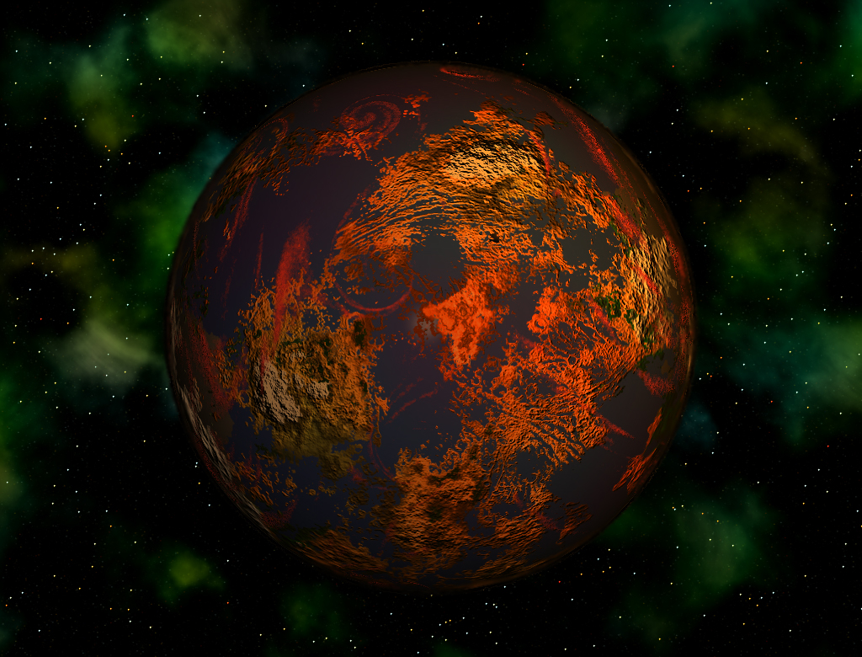
Notes:
If we do not change and adapt to greener living our beautiful blue earth will not be the same any more.

